Slide 1



Luke Patrick Sprint 6 Power BI Project
View in Power BI
Last data refresh:
3/9/2025 11:45:11 PM UTC
Downloaded at:
3/9/2025 11:47:44 PM UTC

Slide 2
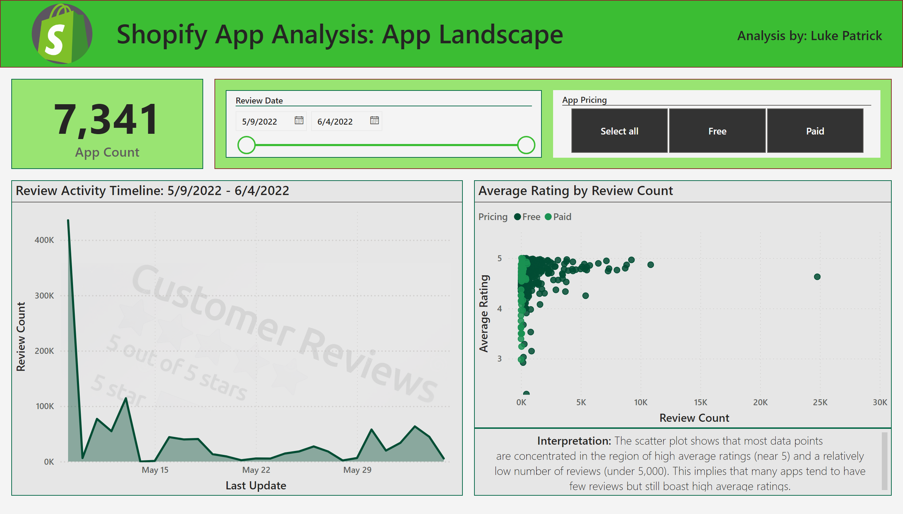
App Landscape
Notes:
card
No alt text provided
Review Activity Timeline: 5/9/2022 - 6/4/2022
No alt text provided
slicer
No alt text provided
textbox
No alt text provided
Shopify App Analysis:
No alt text provided
image
No alt text provided
shape
No alt text provided
Average Rating by Review Count
No alt text provided
shape
No alt text provided
slicer
No alt text provided
textbox
No alt text provided

Slide 3
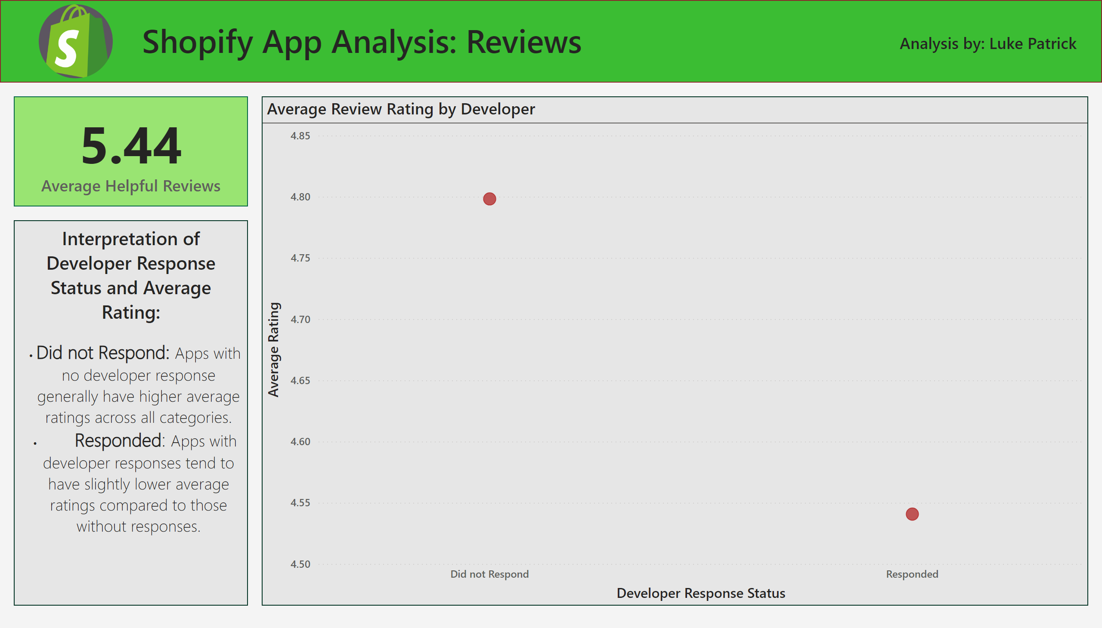
Reviews
Notes:
textbox
No alt text provided
Shopify App Analysis:
No alt text provided
image
No alt text provided
shape
No alt text provided
card
No alt text provided
Average Review Rating by Developer
No alt text provided
textbox
No alt text provided
textbox
No alt text provided

Slide 4
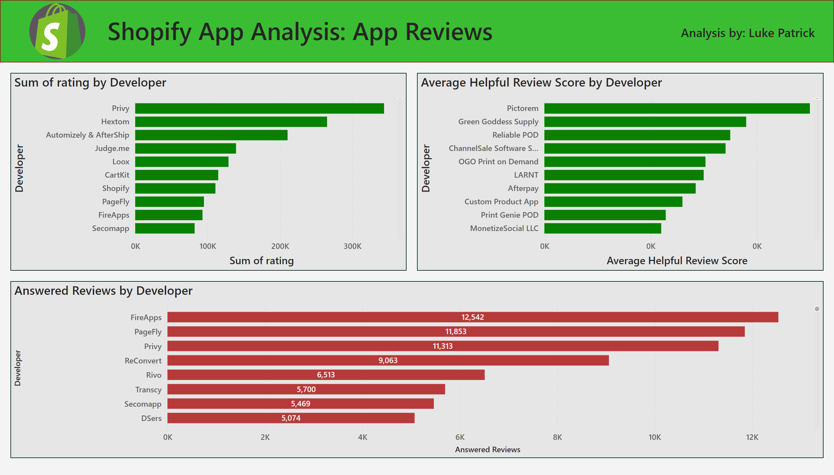
App Reviews
Notes:
textbox
No alt text provided
Shopify App Analysis:
No alt text provided
image
No alt text provided
shape
No alt text provided
barChart
No alt text provided
Average Helpful Review Score by Developer
No alt text provided
Answered Reviews by Developer
No alt text provided

